Slide 1
Chapter 3
Image Enhancement in the Spatial Domain

Slide 2
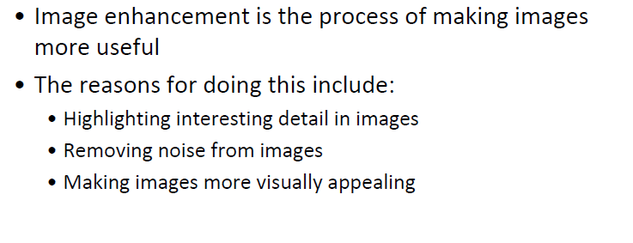
Image Enhancement

Slide 3
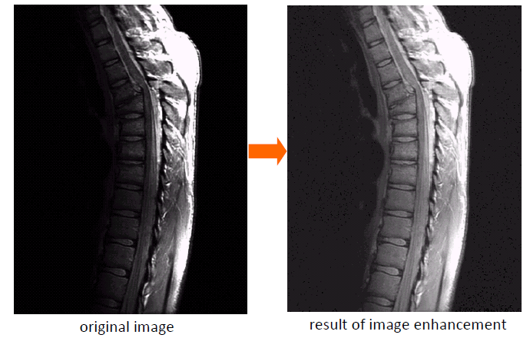
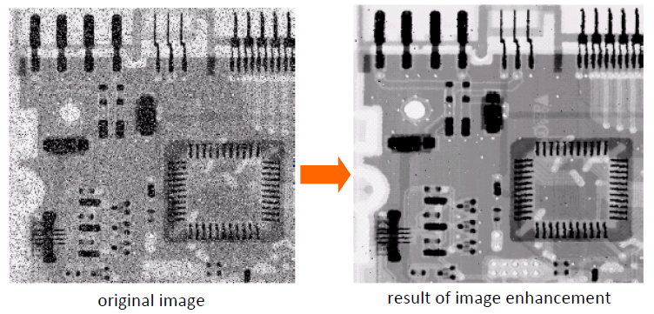
Image Enhancement - Examples

Slide 4
Image Enhancement
Spatial domain VS frequency domain
Spatial domain techniques directly manipulate image pixels
Frequency domain techniques manipulate fourier transform or wavelet transform of an image

Slide 5
Image Enhancement
Some basic intensity transformation functions
Image negatives
Thresholding
Log transformations
Power‐law (Gamma) transformations
Piecewise‐linear transformation functions

Slide 6
Basic Concepts
Spatial domain methods are procedures that operate directly on these pixels. Spatial domain processes will be denoted by the expression
g(x, y) = T[ f(x, y)]
where f(x, y) is the input image, g(x, y) is the processed image, and T is an operator on f, defined over some neighborhood of (x, y).

Slide 7
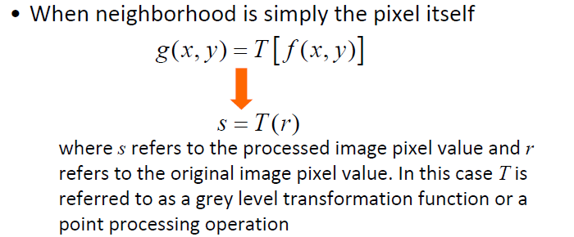
Basic Concepts
s = T(r)
r: original intensity
s: new intensity

Slide 8
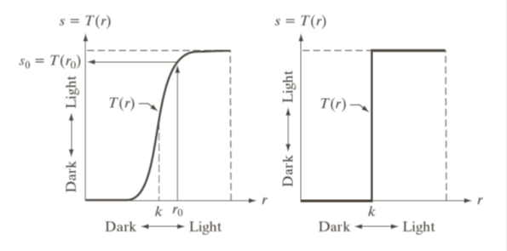
Basic Concepts
Produce an image of higher contrast than the original by darkening the levels below k and brightening the levels above k in the original image.
Dark will be more darker and white will be more whiter is known as contrast stretching

Slide 9
Basic Gray Level Transformations

Slide 10
Basic Gray Level Transformations
There are many different kinds of grey level transformations
Three of the most common are shown:
Linear
Identity/Negative
Logarithmic
Log/Inverse log
Power law
n^{th} power/n^{th} root

Slide 11
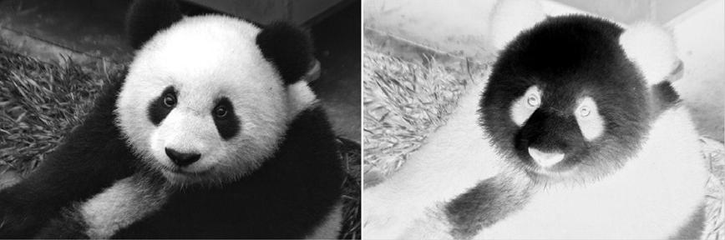
Image Negatives
The negative of an image with gray levels in the range [0,L-1]is obtained by using the negative transformation, which is given by the expression
s = L - 1 – r
s = 256-1-r
panda Image (a), and its photographic negative transformed image (b).
This type of processing is particularly suited for enhancing white or gray detail embedded in dark regions of an image, especially when the black areas are dominant in size.

Slide 12
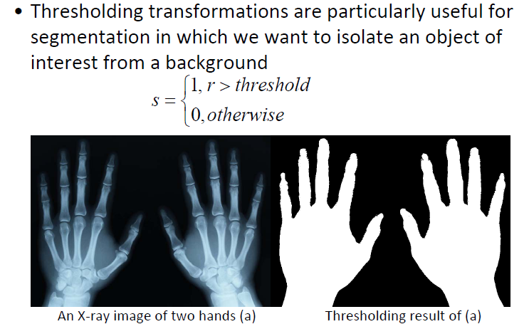
Thresholding

Slide 13
Log Transformations
The general form of the log transformation
s = c log (r +1)
where c is a constant, and it is assumed that r >= 0
The log transformation maps a narrow range of low input grey level values into a wider range of output values.
The inverse log transformation performs the opposite transformation.

Slide 14
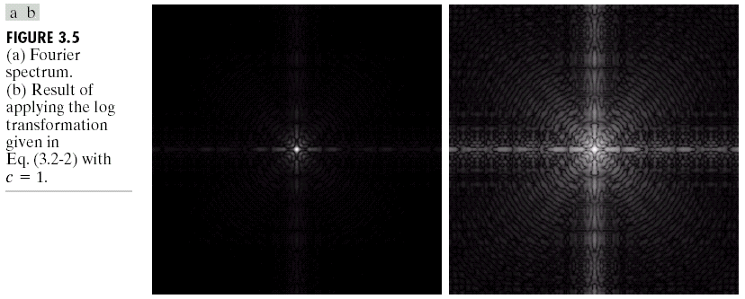
Log Transformations
Log functions are particularly useful when the input grey level values may have an extremely large range of values
In the following example the Fourier transform of an image is put through a log transform to reveal more detail
Expand dark value to enhance details of dark area

Slide 15
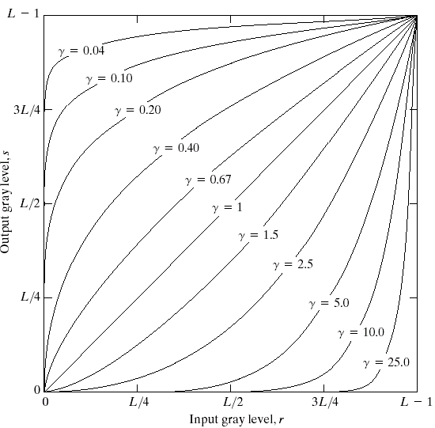
Power-Law Transformations
Power law transformations have the following form
s = c * r ^{γ}
^{S=r.^0.5}
Map a narrow range of dark input values into a wider range of output values or vice versa
Varying γ gives a whole family of curves

Slide 16
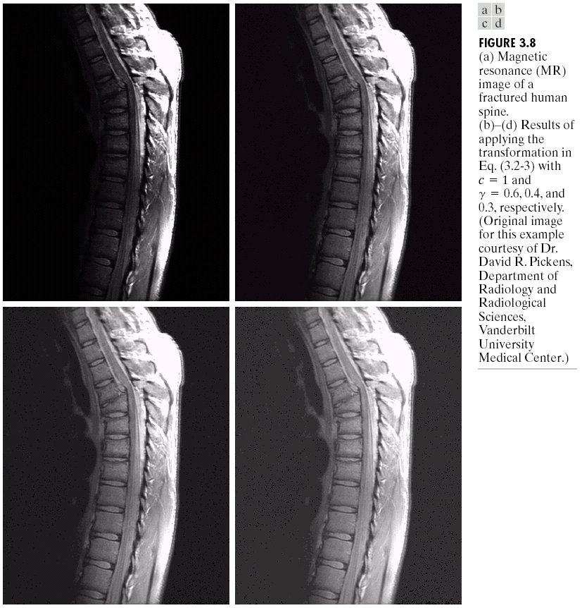
Power Law Example

Slide 17
Power Law Example (cont…)
γ = 0.6

Slide 18
Power Law Example (cont…)
γ = 0.4

Slide 19
Power Law Example (cont…)
γ = 0.3

Slide 20
Power Law Example (cont…)
The images to the right show a magnetic resonance (MR) image of a fractured human spine
Different curves highlight different detail
s = r ^{0.6}
s = r ^{0.3}
s = r ^{0.4}

Slide 21
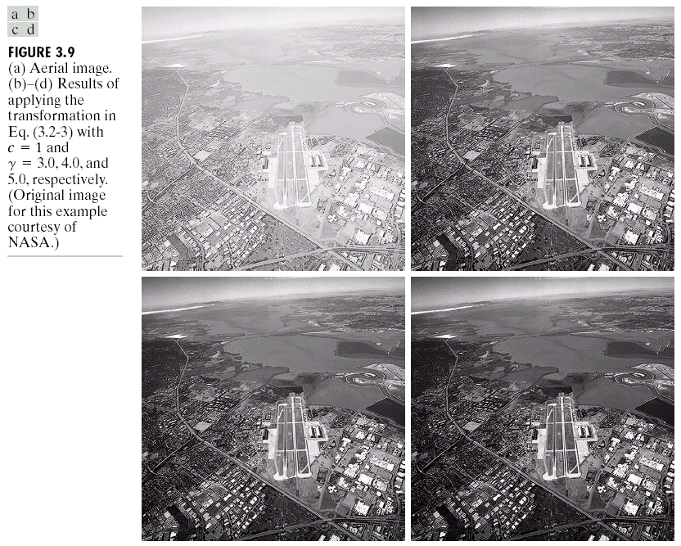
Power Law Transformations (cont…)
Original image
Power Law
transforms are used to darken
the image
Different curves highlight different detail
s = r ^{3.0}
s = r ^{4.0}
s = r ^{5.0}

Slide 22
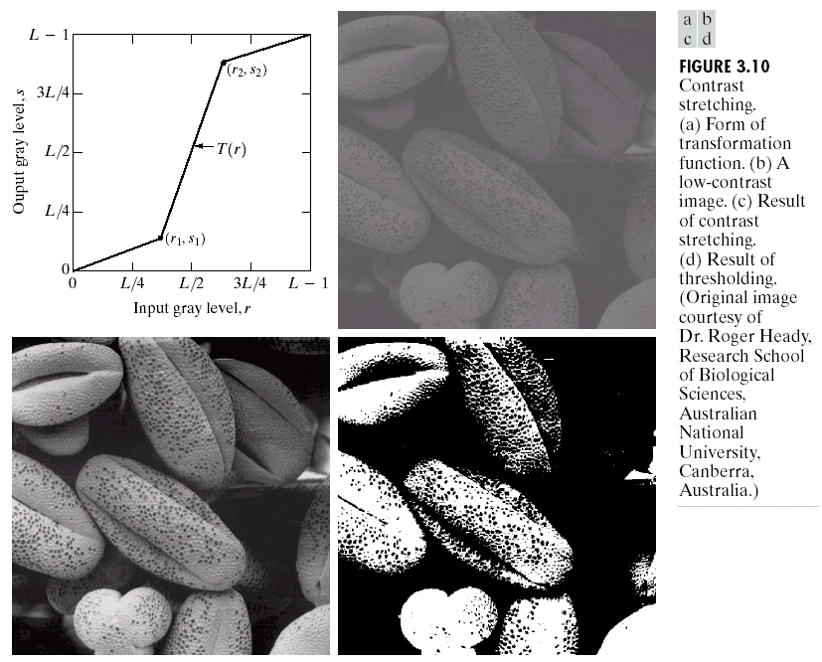
Piecewise Linear Transformation Functions
Rather than using a well defined mathematical function we can use arbitrary user-defined transforms
The images below show a contrast stretching linear transform to add contrast to a poor quality image

Slide 23
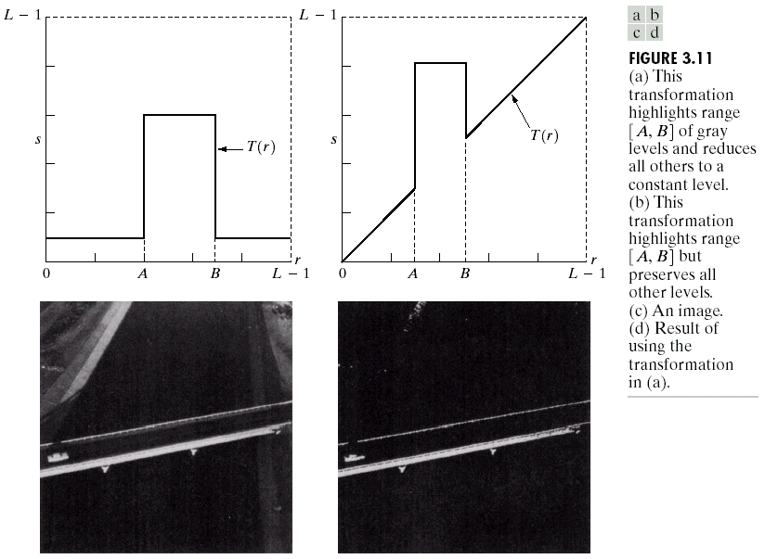
Gray Level Slicing
Highlights a specific range of grey levels
Similar to thresholding
Other levels can be suppressed or maintained
Useful for highlighting features in an image

